Slide 1



IES PROJECT
ASP.NET core web application.
GROUP MEMBERS:
RAHUL MENARIA- 200563265
RAHUL MENARIA -200555789
ISHMEET KAUR-200591350
MEGHA PATEL - 200590965

Slide 2
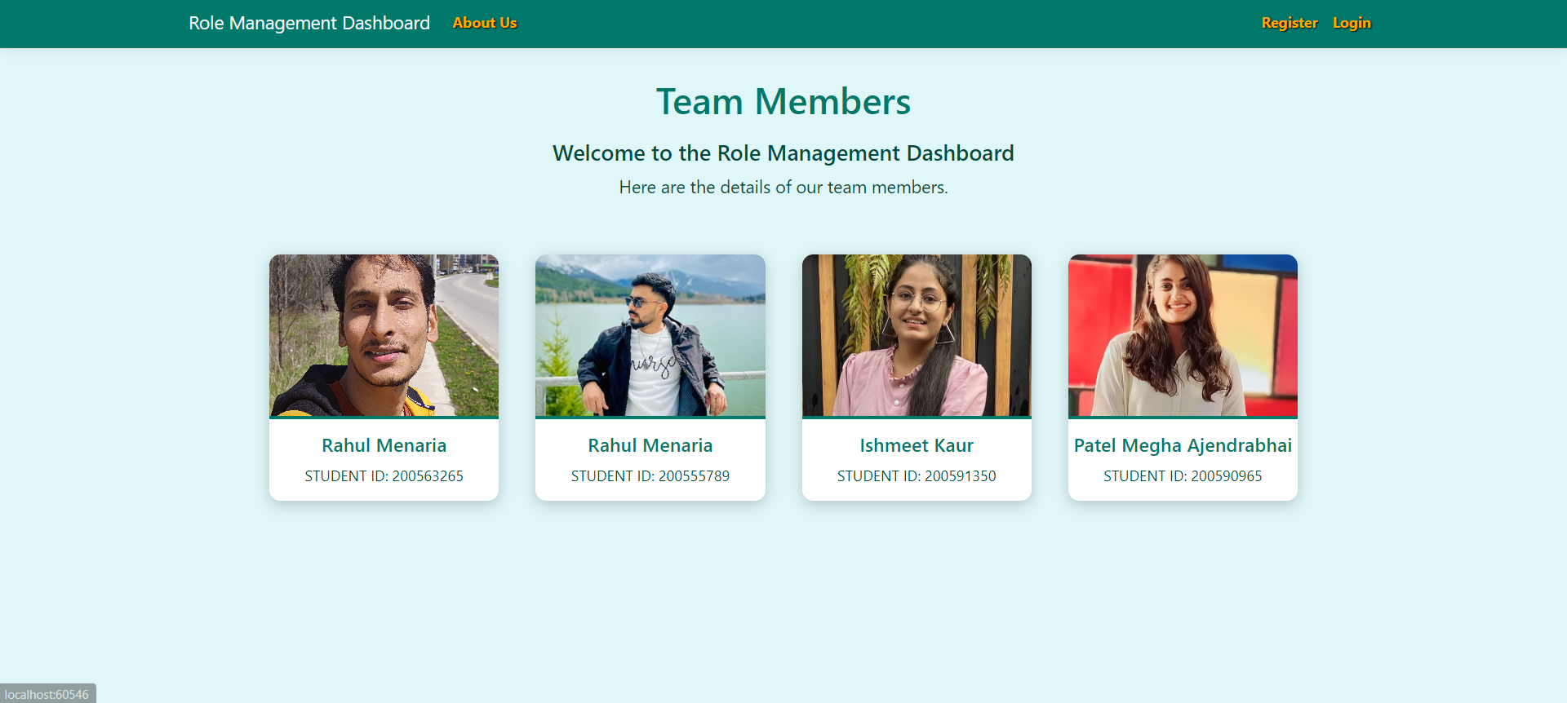
TEAM MEMBERS

Slide 3




OVERVIEW
Introduction
Technologies & Tools used
Visual representation
Data management
potential improvement
conclusion

Slide 4


Introduction
The creation of an ASP.NET Core web application with user-authenticated access is described in this paper. Users have access to a list of their registered contacts after being placed into security groups. Each security group has the following permissions:
Registered users - Have the ability to read permitted data and edit or remove their personal data.
Managers - Have the authority to accept or reject contact details only approved users can approve contacts.
Administrators - Have the authority to approve, reject, edit or delete any content.

Slide 5
TECHNOLOGY & TOOLS
ASP.NET Framework: Visual Studio was used to create the website, utilizing its powerful.NET features for creating web apps.
C# programming language: It is used by the ASP.NET framework to manage backend activities and server-side scripting.
HTML & CSS - We used HTML & CSS for front-end development to create a user interface that is both visually appealing and responsive.
SQL Server Management Studio (SSMS): When creating and managing a SQL Server database, SSMS is utilized to guarantee data security and integrity.

Slide 6

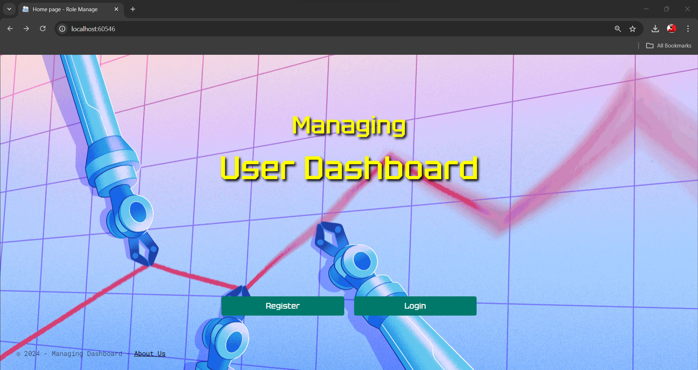
HOME PAGE

Slide 7

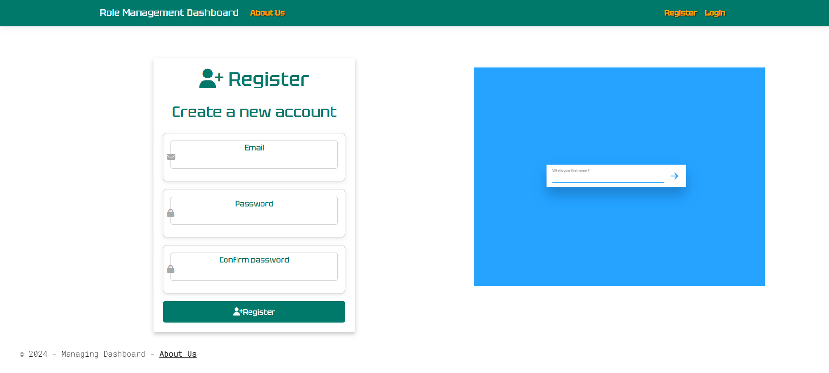
REGISTRATION

Slide 8

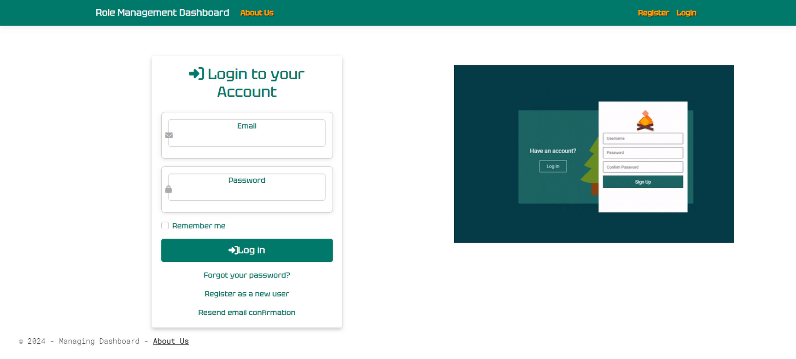
LOGIN PAGE

Slide 9


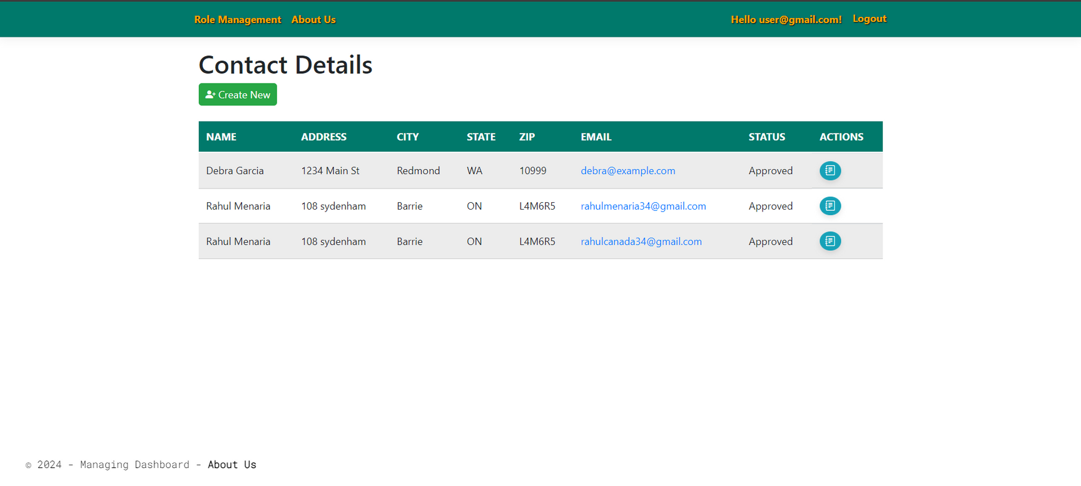
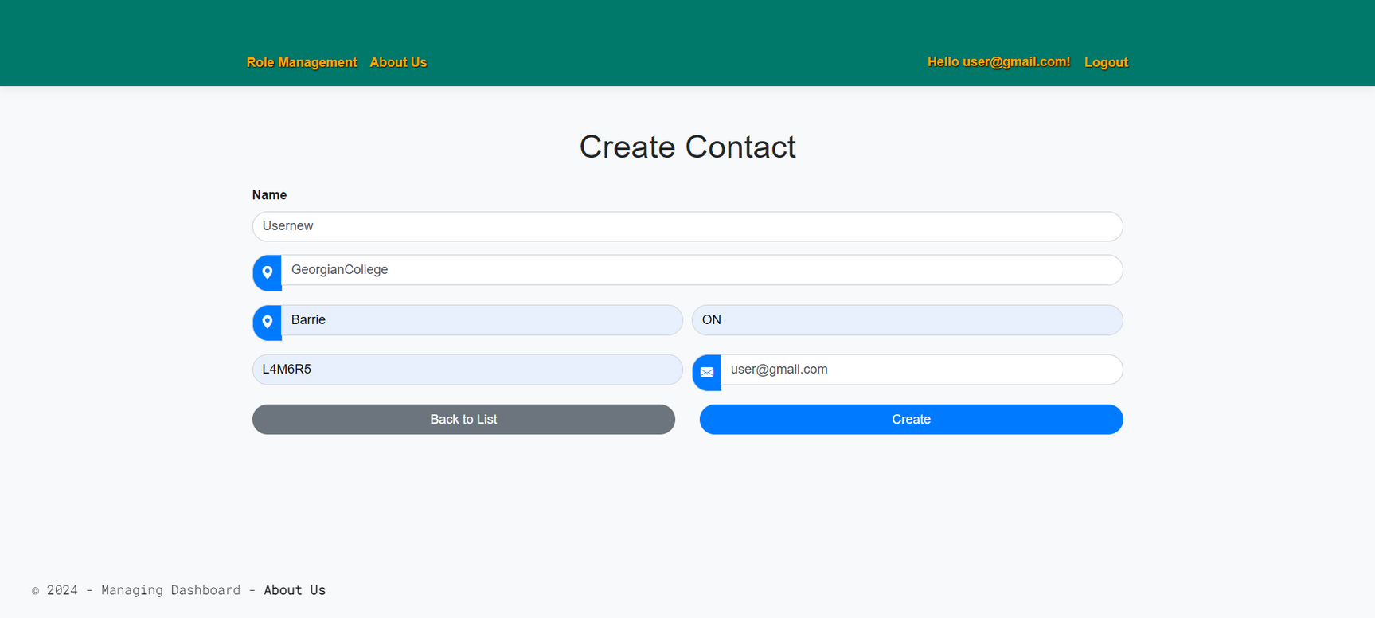
USER’S VIEW
USERS ARE TAKEN TO THEIR DASHBOARDS AFTER REGISTERING.
BY COMPLETING AND SUBMITTING A FORM, USERS REGISTER. USERS MUST SEND AN EMAIL TO CONFIRM THEIR ACCOUNT AFTER REGISTERING.

Slide 10
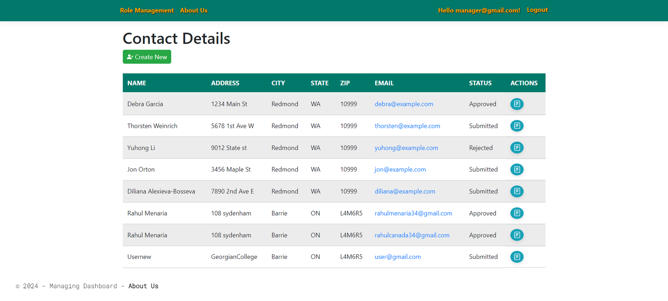
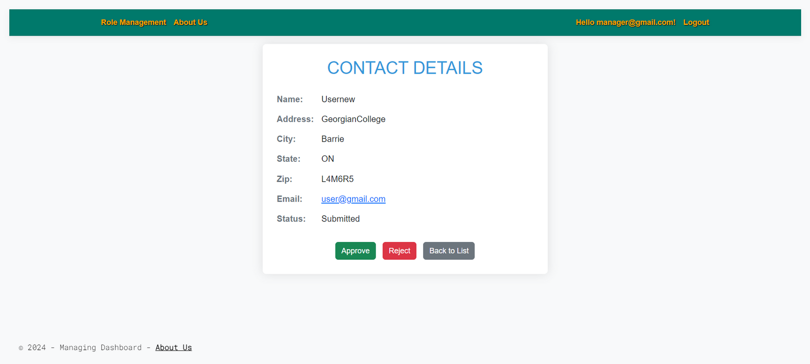
MANAGER’S VIEW
MANAGERS HAVE THE ABILITY TO ADD NEW USERS, SEE WHO ALREADY EXISTS, AND ACCEPT OR REJECT USER REQUESTS.
THEY HAVE THE ABILITY TO ACCEPT OR REJECT USER REQUESTS USING THE DETAILED VIEW.

Slide 11
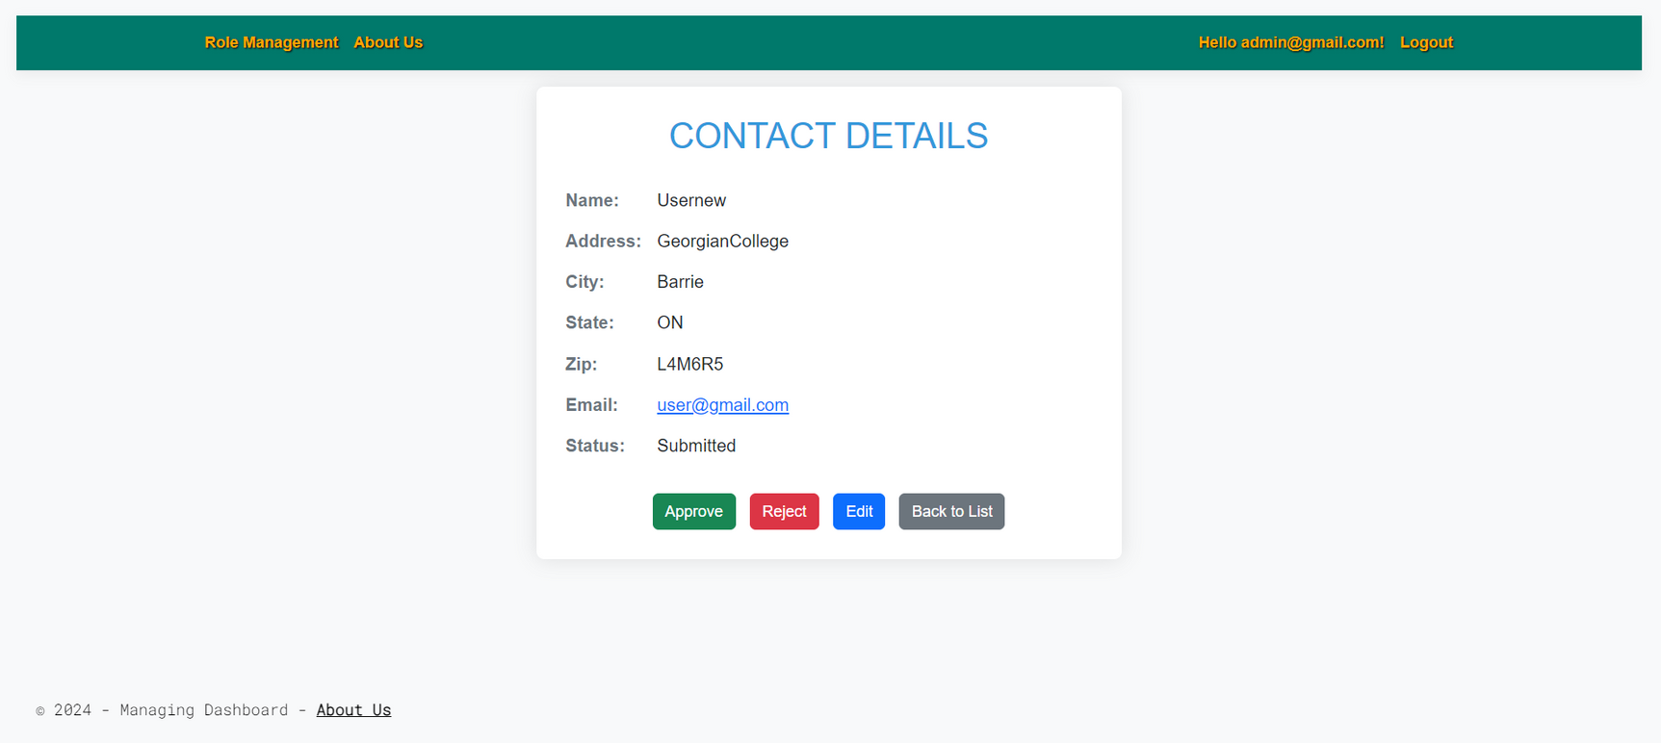
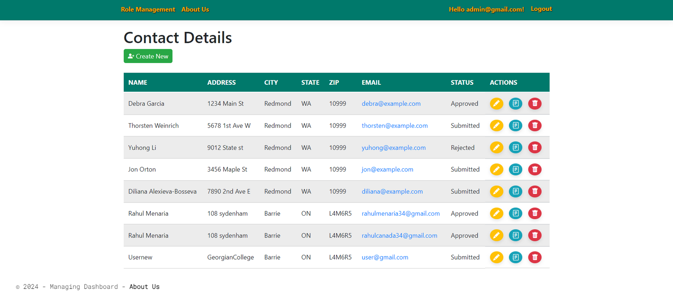
ADMIN’S VIEW
ADMINS HAVE COMPLETE CRUD (CREATE, READ, UPDATE, DELETE) POWERS FOR ALL USERS AND CAN ADD NEW ONES.
THE ADMINISTRATOR COMPLETES A FORM AND SUBMITS IT TO ADD A NEW USER. THEY CAN GO BACK TO THE PRIOR LIST IF THEY DECIDE NOT TO CONTINUE.

Slide 12

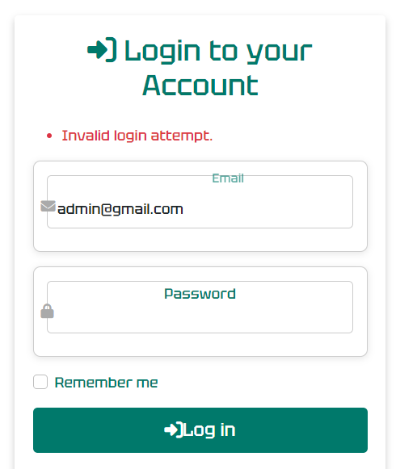
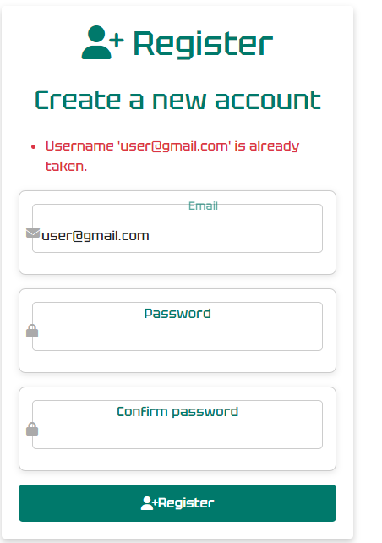
ERROR HANDLING
Duplicate User: "Username 'example@example.com' is already taken." - Select a distinctive, separate username.
Missing Fields: "The email field is required." Ensure that all fields are filled out before submitting.
Incorrect Credentials: "Invalid email or password." - Use 'Forgot your password?' or confirm your email and password.

Slide 13
DATA MANAGEMENT

Slide 14
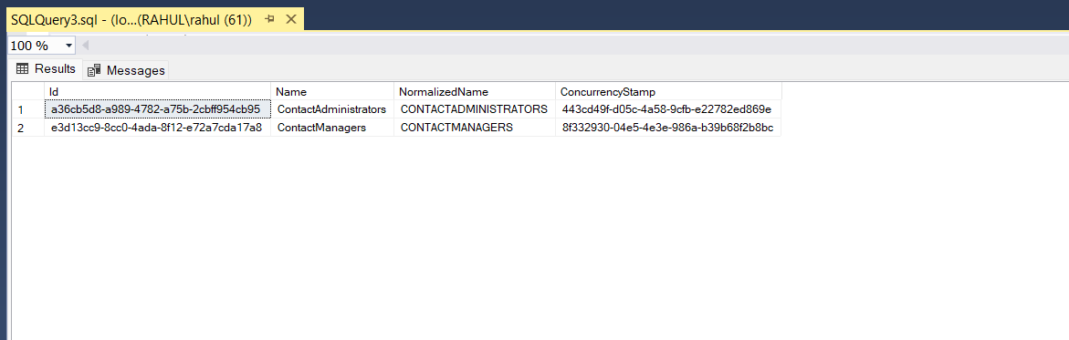
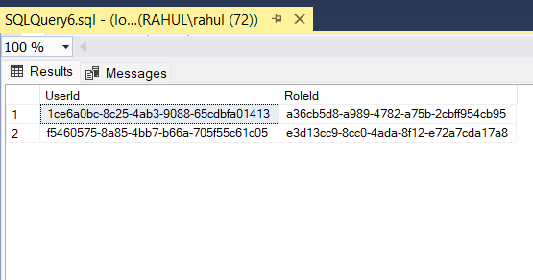


Slide 15
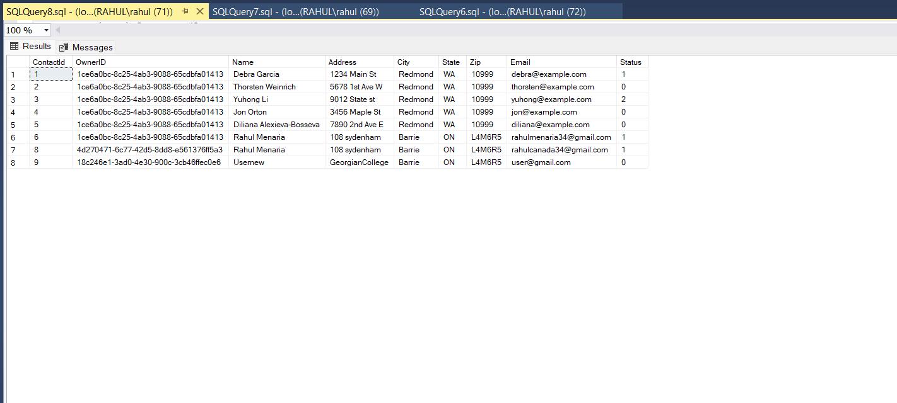
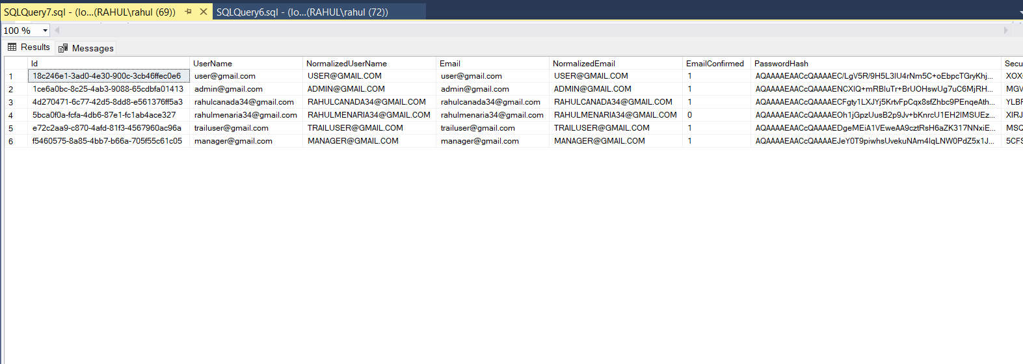

Slide 16
Potential Improvements
FUTURE DEVELOPMENT: ADVANCED SECURITY FEATURES ARE INCLUDED USING ASP.NET IDENTITY.
OPTIMIZATION: FURTHER IMPROVEMENTS IN APP USING HTML AND CSS.
SCALABILITY: ASP.NET CORE IMPLEMENTATION FOR ENHANCED CROSS-PLATFORM INTEROPERABILITY AND PERFORMANCE.
SUPPORTING FEATURES: INTRODUCING DYNAMIC DATA VISUALIZATION USING HTML5 AND CSS3 FOR ENHANCED USER INVOLVEMENT AND RESULTS.

Slide 17
CONCLUSION
THIS ASP.NET CORE WEB APPLICATION SUCCESSFULLY COMBINES EXTENSIVE ERROR HANDLING, USER-FRIENDLY INTERFACES, AND STRONG SECURITY. BY UTILIZING TECHNOLOGIES SUCH AS SQL SERVER, ASP.NET, C#, HTML, AND CSS, IT GUARANTEES A SCALABLE AND RESPONSIVE PLATFORM. UPCOMING IMPROVEMENTS WILL RAISE THE BAR FOR SECURITY, PERFORMANCE, AND DATA VISUALIZATION EVEN HIGHER, GIVING THIS APPLICATION A STRONG PLATFORM FOR GROWTH AND INNOVATION IN THE FUTURE.

Slide 18
THANK YOU

